Slide 1


How to use
        Ajou Portal

Slide 2
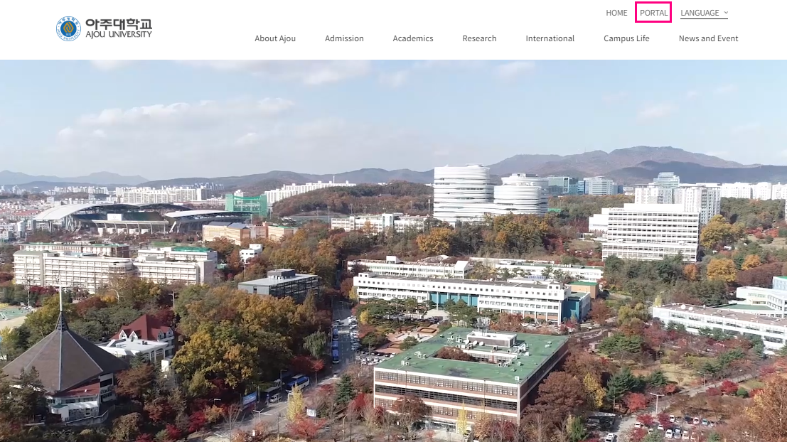
            How to create Ajou ID & PW
How to get to Ajou Portal (https://www.ajou.ac.kr/en/index.do) ☞ Click ‘Portal’
Click

Slide 3
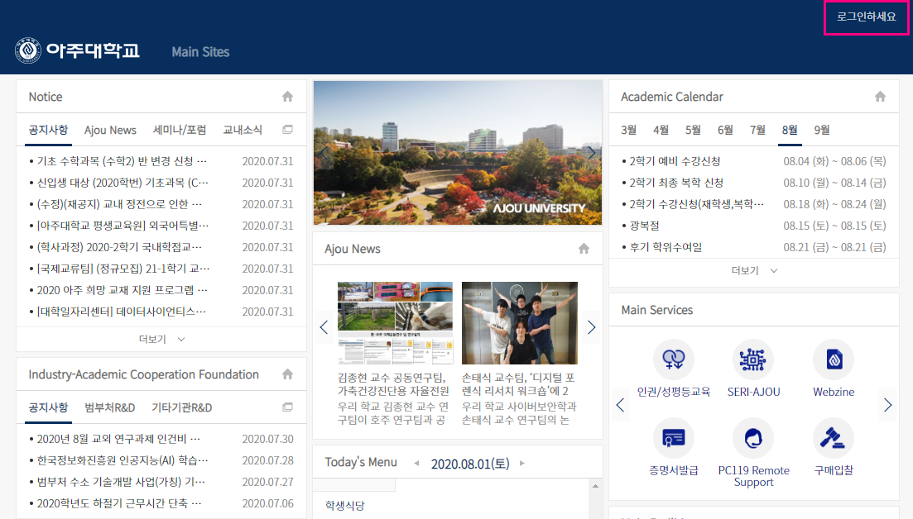
            How to create Ajou ID & PW
Once in Portal ☞ Click ‘로그인하세요’ which means ‘Login’
Click

Slide 4
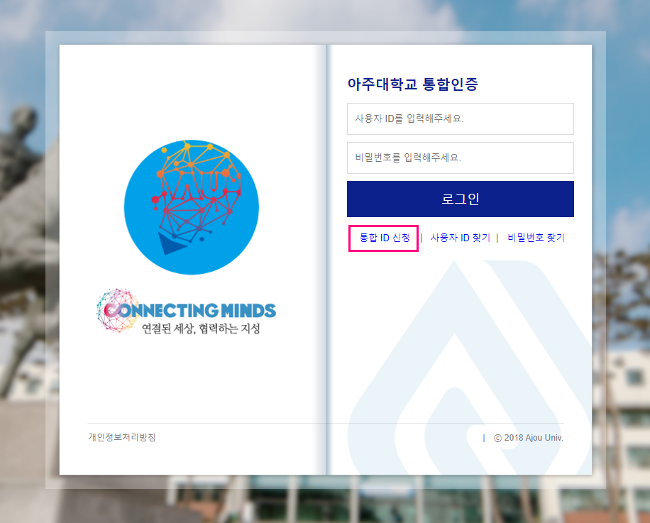
            How to create Ajou ID & PW
Once you get in to the log in page ☞ Click ‘통합 ID 신청’
Click

Slide 5
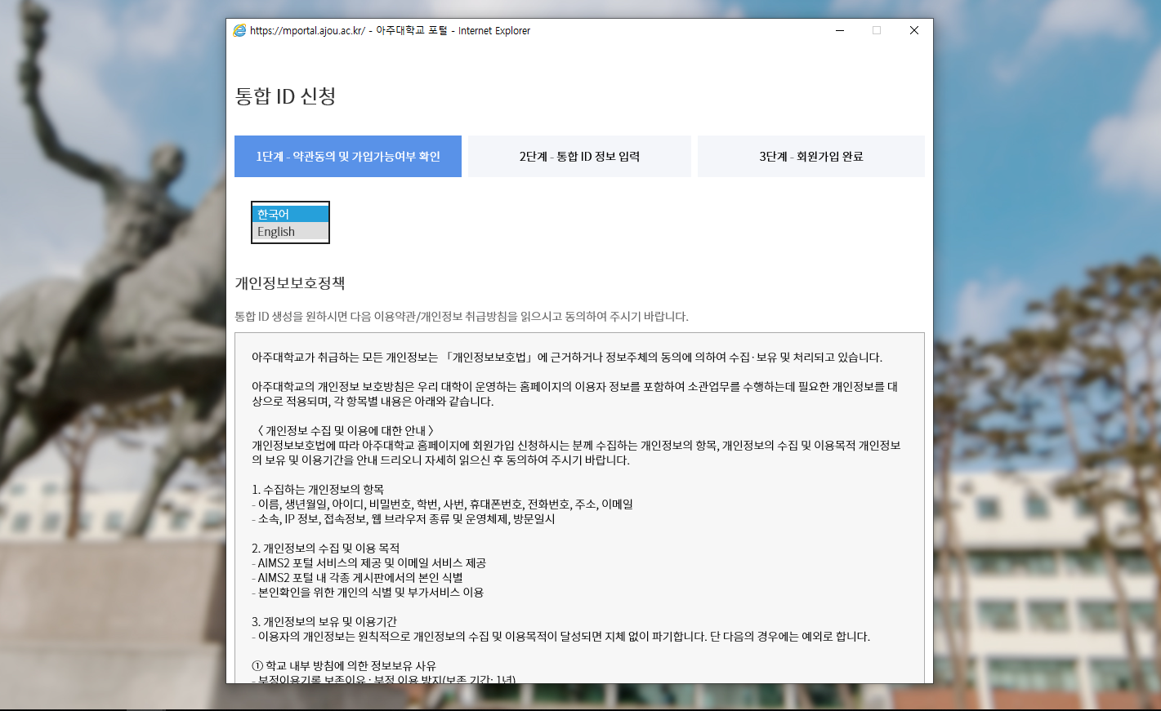
            How to create Ajou ID & PW
Once you get in to the log in page ☞ Switch to ‘English’
Click

Slide 6
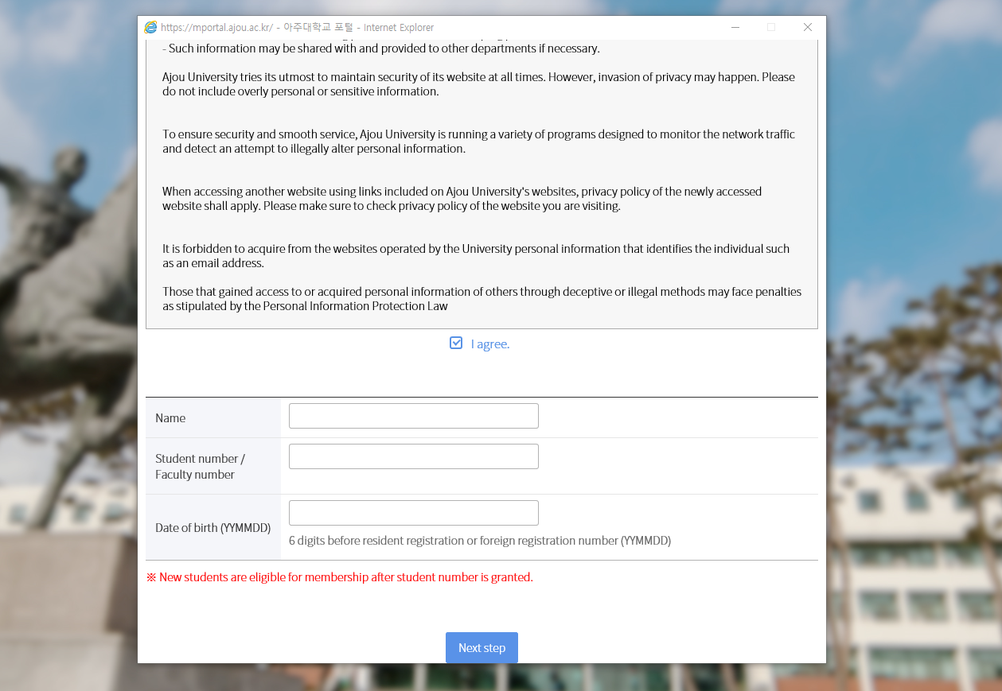
            How to create Ajou ID & PW
Read over the Privacy policy statement ☞ Click ‘I agree’
Check

Slide 7
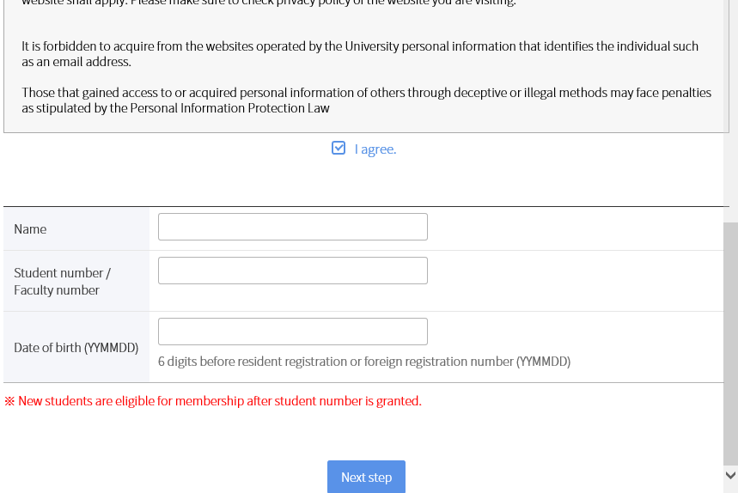
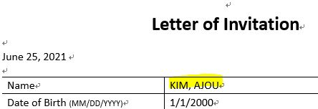
            How to create Ajou ID & PW
①
Exact name written on Letter of Invitation
(All in Capital Letters, include comma and spacing)
Exact name found through : https://mhaksa.ajou.ac.kr:30443/public.html#!/e010402
(All in Capital Letters, include comma and spacing)
Ajou Student ID Number
②
①
②

Slide 8
            How to create Ajou ID & PW
YY-MM-DD
If your date of birth is 1995 / August / 30
=> 950830
Button for ‘Next Step’

Slide 9
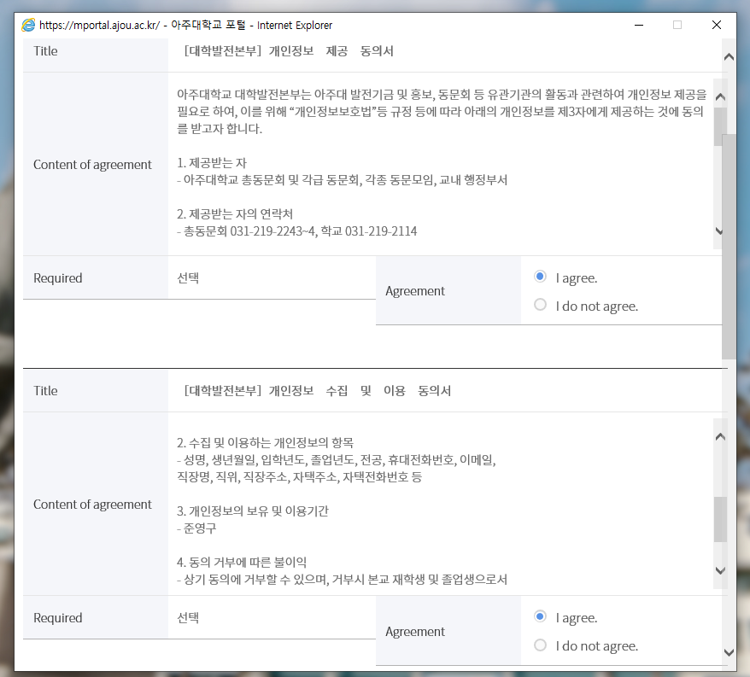
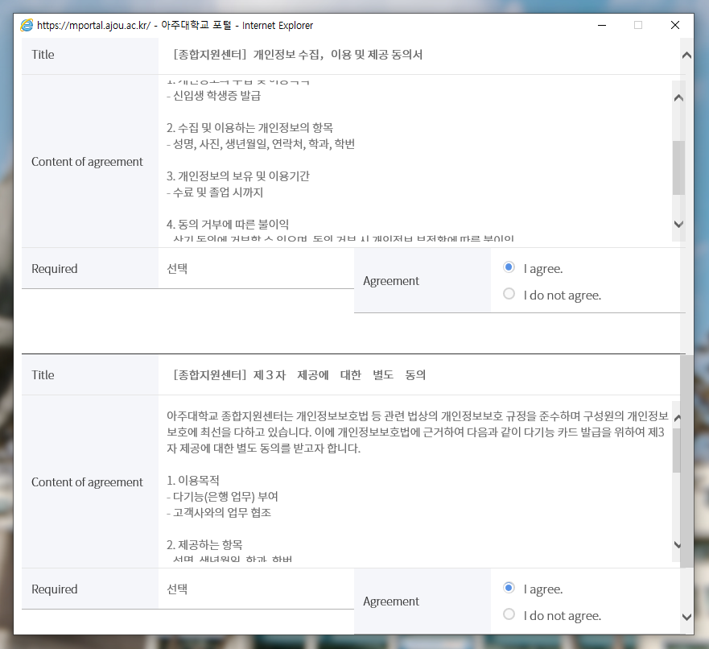
            How to create Ajou ID & PW
Check every ‘I agree’ boxes

Slide 10
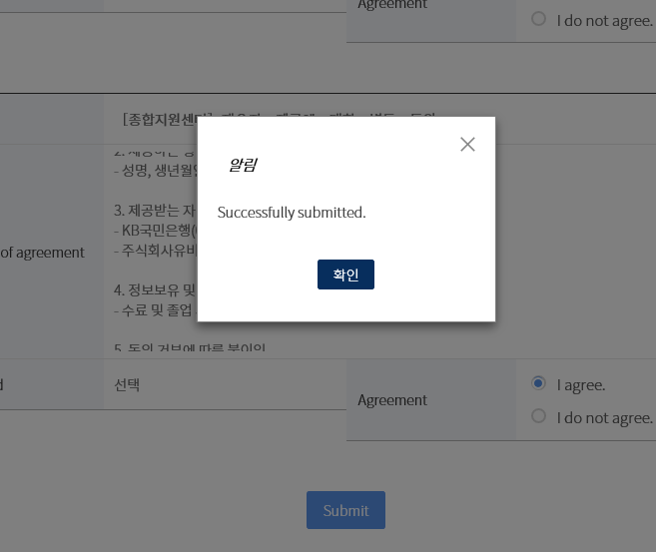
            How to create Ajou ID & PW
Click ‘Submit’

Slide 11
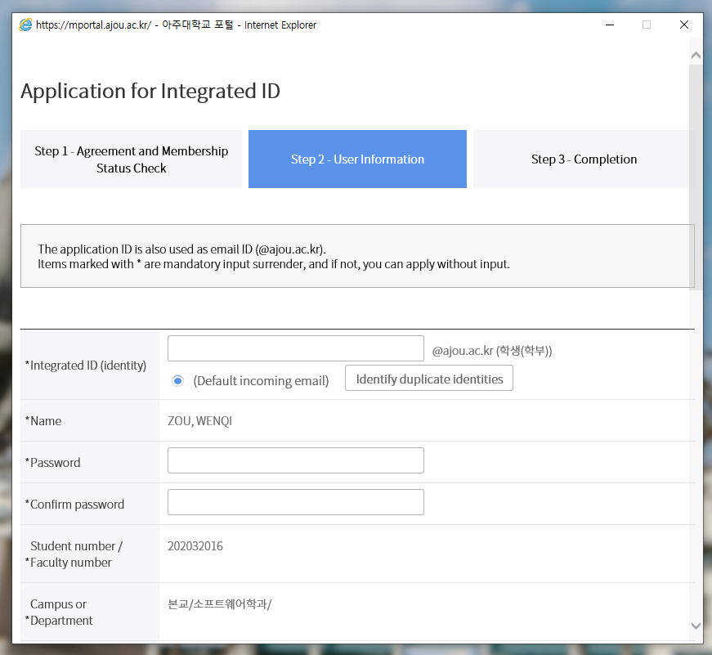
            How to create Ajou ID & PW
Password:
At least 10 letters combined with numbers
Check duplicate ID

Slide 12
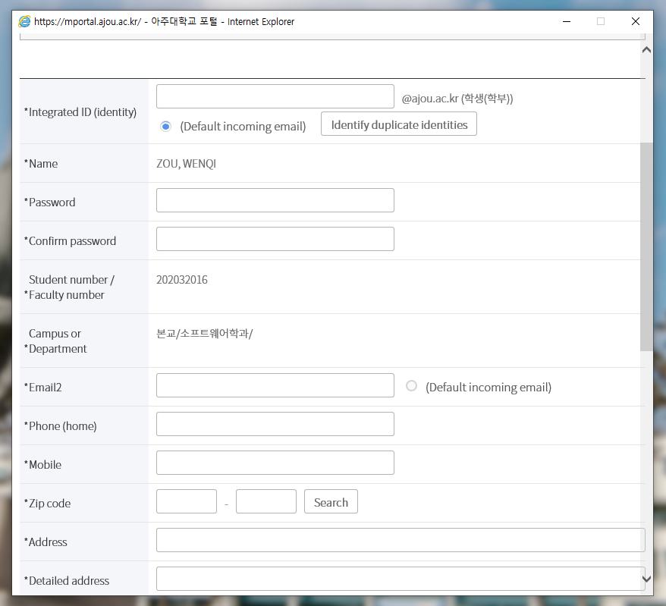
            How to create Ajou ID & PW
You can also type your telephone number of home country
(agree to e-mail notification)
Your dormitory address/off-campus address

Slide 13
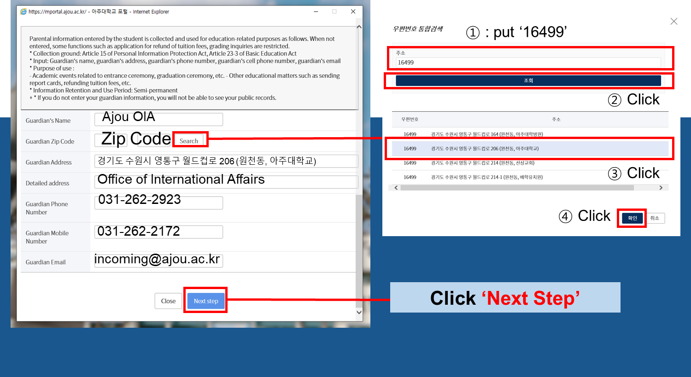
            How to create Ajou ID & PW

Slide 14
            How to log in with Ajou ID & PW
Go to mportal.ajou.ac.kr/main.do to log in ☞ Click ‘로그인하세요’
Click

Slide 15
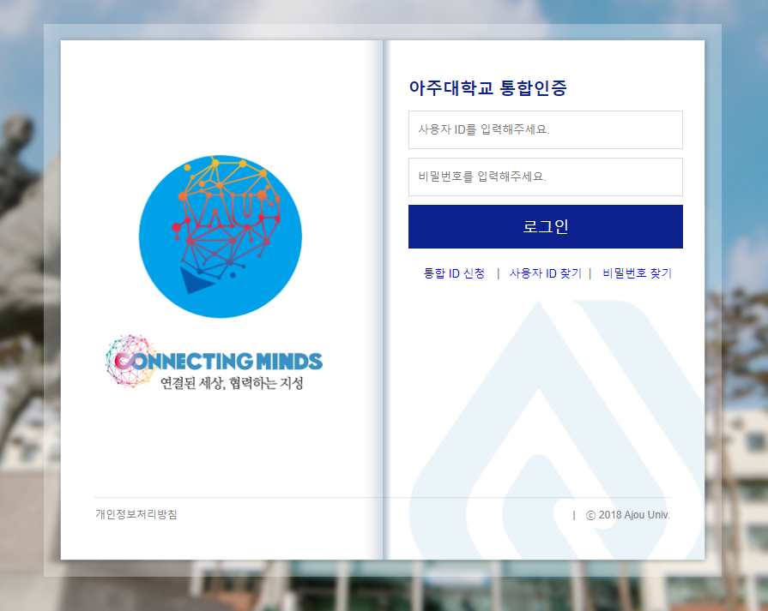
            How to log in with Ajou ID & PW
▪ Ajou ID
(do not include “@ajou.ac.kr”)
▪ Password

