Slide 1

Training for Ajou Students Participating in Global Programs
  Office of International Affairs
Notes:
Module 0. Introduction
Memo

Slide 2
Contents
Covid-19 Cases
Covid-19 안전수칙
Personal Safety Abroad 해외 안전수칙
(1) Personal Safety 개인 안전
(2) Health and Self-care (including Mental Health) 건강
(3) Monitoring Alcohol consumption 음주
(4) Avoiding dangerous social situations 위험장소 피하기
(5) Self Defense 자기 보호
Reminder 숙지사항
Culture Shock 문화충격
      (1) Symptoms of Culture Shock
Global Etiquette 글로벌 에티켓
Conclusion 마치며

Slide 3
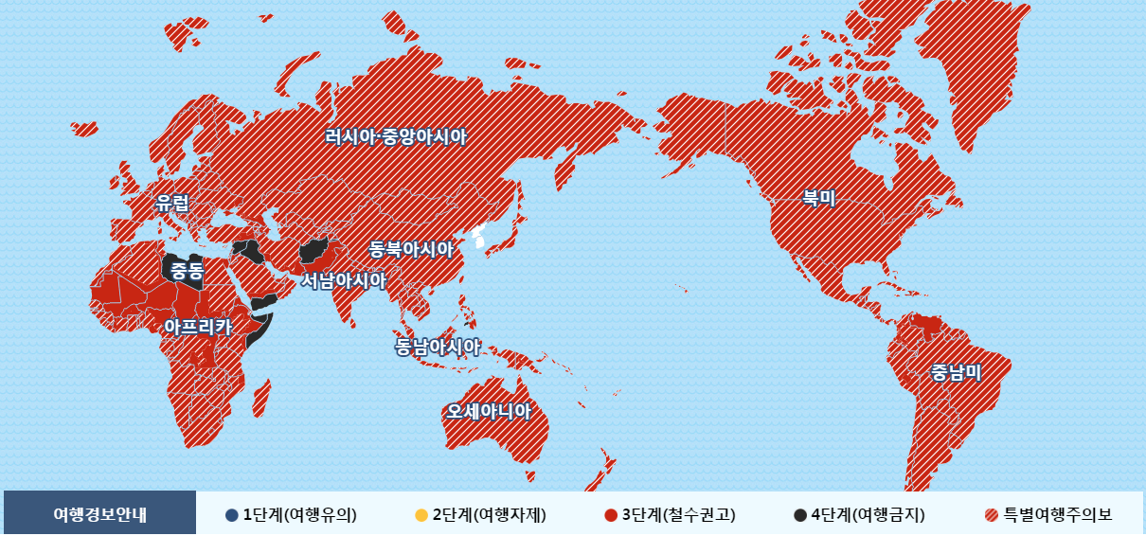
1. Covid-19 Cases
Globally, as of 30 December 2020, there have been 80,773,033 confirmed cases of COVID-19, including 1,783,619 deaths, reported to WHO.

Slide 4

2. Covid-19 안전수칙
해외 코로나19 관련 범죄 피해 방지 유의
한국인 포함 아시아계 국민에 대한 각종 범죄 유의
- 시간에 관계없이 인적이 드문 곳 출입 삼가
- 모욕적인 언사 등으로 자극적 행동을 보이거나 접근해 오는 사람들에 대해
더 이상 상황이 악화되지 않도록 접촉 회피 (필요 시, 경찰이나 주변 관리자 등에게 도움 요청)
  - 범죄 피해 등 발생 시 긴급전화 또는 주변에 신고
  (특히 즉각적인 대응이 가능한 현지 경찰에 우선적으로 도움 요청 후 대한민국 공관으로 연락)
  - 자가격리 지침이나 사회적 거리두기 등 해당 국가의 각종 지침, 명령등을 철저히 준수
각 국가별 대한민국 공관의 연락처 저장
- 필요 시, 국내 영사콜센터 +82-2-3210-0404를 통해 신속히 도움 요청
- 외교부 해외안전여행 (https://www.0404.go.kr/dev/main.mofa)의 공지 및 카카오톡 상담 활용

Slide 5
3. Personal Safety Abroad
TIPS FOR Personal Safety
Be alert all the time! (겁도 나지만 새로운 환경에서 매우 흥분된 상태!)
- You will get to be less intimidated and more adventurous as time passes,
and that is the time you are the most vulnerable.
  - Don’ t get over-excited
  - Enjoy controlled, self-regulated freedom
  - Respect your host country
Share your itinerary (행선지에 대해서 항상 알리기!)
- Make sure that you have a safety support network around you (Friends, staff,
emergency contact, maintaining contact with your family and friends in Korea SNS etc.)

Slide 6
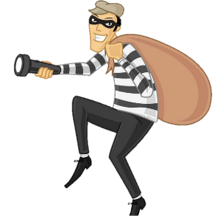
3. Personal Safety Abroad
TIPS FOR Personal Safety
Be mindful when handing your luggage. Thieves often pose as porters or drivers. At the airport, save your checked luggage receipts because you might need them to be able to leave with your luggage at baggage claim. (공항에서 짐 훔쳐가는 경우 있음 조심!)
Plan your trip ahead of time so that you don’t arrive at an unknown town late at night without having made prior arrangements for accommodations (행선지에 대해서 미리 계획!)

Slide 7
3. Personal Safety Abroad
TIPS FOR Personal Safety
When you stay at a hotel, make use of the safe. Leave your passport, money and electronics safely locked away. Use luggage locks anytime you leave the room. Make copies of your passport and keep somewhere not your luggage(호텔에 잠시 머무를 경우, 여권 등은 금고에 넣고 다니기!, 여권사본이나 사진자료로 신분확인!)
If driving, keep doors locked & suitcases out of sight. Don’t leave valuables in cars. Thieves target rental cars and vehicles with foreign license plates.
(독일이나 미국같은 국가에서, 귀중품을 트렁크에 넣지 않고, 뒷좌석에 놓아 도둑들로 하여금 견물생심!
훔치고 싶은 마음을 불러 일으켰다고 운전자나 차주의 책임으로 묻는 경우가 빈번함)

Slide 8
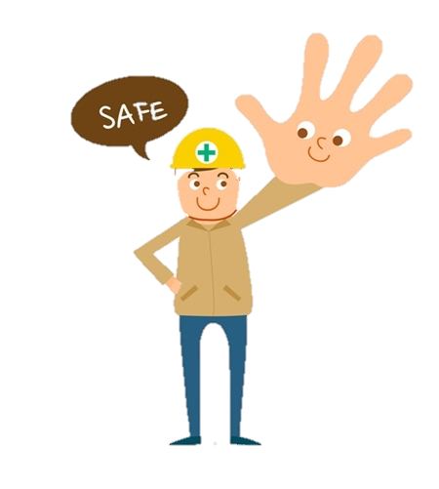
3. Personal Safety Abroad
TIPS FOR Personal Safety
Avoid forming large groups of foreigners. Smaller groups attract less attention. (여행시 너무 큰 그룹으로 다니면 타겟이 될 수 있으니 삼삼오오 소그룹으로 다닐 것)
Don’t go anywhere with strangers if you are alone. (낯선 사람과 동행하지 말 것)

Slide 9
3. Personal Safety Abroad
TIPS FOR Personal Safety
Dress to blend in with the local culture. Research your host country’s culture to see what type of clothing is appropriate to wear for your gender (옷 너무 튀지 않게 입기, 그 나라의 문화 등에 부합될 수 있도록 옷 입기, 이슬람권에서 소매 없는 티셔츠, 너무 짧은 치마, 반바지 등!! 안됨)
Find out which parts of town are considered risky by the locals and avoid those areas (주변에 위험지역에 대해서 미리 알아두기)
Always stay in well-lit and well-traveled places. Don’t take short cuts through alleys or unsafe areas (다닐 때 지름길보다는, 사람들이 많이 다니는 도로로 이용하여 다니기!)

Slide 10
3. Personal Safety Abroad
TIPS FOR HEALTH AND SELF-CARE
Check Important Medical Information for tips to prepare to study abroad that may help prevent health issues during your program. (해외 여행자 보험 모두 가입! 간단한 조치사항은 미리 알아두고 갈 것!)
Consult with Coordinators for any problems. Talk to your host university/company coordinator if you are experiencing any physical or mental health problems (도착 후 육체적으로 정신적으로 조금이라도 이상한 상황이 발견되면 즉시 상대교/회사 관계자에게 알릴 것!)

Slide 11
3. Personal Safety Abroad
TIPS FOR HEALTH AND SELF-CARE
Check emergency treatment before a medical problem arises.
Refer to the Institutional Information Sheet (IIS) you will receive upon your
acceptance into the program for the available physical and mental health services on
campus or locally (상대대학에서 제공한 비상조치관련사항 읽어볼 것, 학교 웹사이트 등
들어가서 인근 병원 등 외국인에게 제공되는 medical service 있는 지 확인할 것!)

Slide 12

3. Personal Safety Abroad
TIPS FOR HEALTH AND SELF-CARE
Have basic supplemental medicine available if you have a chronic disease, have enough personal medicine, write down the medical information provided by the host university honestly, and check the information in advance in case of emergency (기본적인 상비약 구비, 지병이 있는 경우 개인 약 충분히 구비, 상대교에 제공하는 Medical information에 솔직하게 기재하고, 긴급 상황을 대비해서 도움을 받을 수 있는 정보 사전 확인)

Slide 13
3. Personal Safety Abroad
TIPS FOR HEALTH AND SELF-CARE
Prepare sufficient medicine in advance. If there is any medication you normally take, the customs procedures may be complicated even if you mail it from Korea when the local supply and demand is not available, so if you need it you can have sufficient amount in advance. (평소에 복용하는 약이 있는 경우 의약품의 경우 현지 수급이 안될 때 한국에서 우편으로 발송하더라도 세관 절차가 복잡해 조달의 어려움이 있을 수 있으니 필요한 학생의 경우 미리 사전에 충분한 양을 확보해서 구비해 갈 것)

Slide 14
3. Personal Safety Abroad
TIPS FOR MONITORING YOUR ALCOHOL CONSUMPTION
Research host culture’s social norms and attitudes towards alcohol before arriving. Attitudes toward alcohol consumption vary greatly from country to country.
Never leave your drink unattended (술이나 음료를 방치해 두지 마세요! 나쁜 약의 위험!)

Slide 15
3. Personal Safety Abroad
TIPS FOR MONITORING YOUR ALCOHOL CONSUMPTION
Drink moderately and make wise decisions; drinking may place you at risk because it reduces your awareness and ability to judge potential dangers ( 정신 줄 놓을 수 있음!)
Excessive drinking has been identified as the single greatest risk factor for study abroad students (술이 항상 문제!)
- 외국인 교환학생! 술 마시고 경비업체(a security company) 오토바이 훔쳐 캠퍼스 질주!
- 술 마시고 기숙사내 소화기(fire extinguisher) 난동 사건!

Slide 16
3. Personal Safety Abroad
TIPS FOR AVOIDING DANGEROUS SOCIAL SITUATIONS
Stay alert and trust your intuition when you feel you may be in danger. If you feel you may be getting into an uncomfortable situation, try to get to a safe place as soon as possible (위험 감지 시 안전한 곳으로 대피!)
Remember emergency numbers in your host country and use it when needed(비상연락망!)
Memorize your address and add it in your smart phone before going out just in case you forget it (거주지 주소 암기!, 호스트 국가 언어로 쓴 것도 가지고 다니기! 모든 사람이 영어를 하지는 않음!)

Slide 17
3. Personal Safety Abroad
TIPS FOR AVOIDING DANGEROUS SOCIAL SITUATIONS
Don’t be afraid to call attention for help or ask for assistance if you’re in trouble. When calling for help, be specific about what you need(도움을 청할 때는 구체적으로!!! 초기 정착 시 핸드폰 구글 번역기! 사전앱 등!! 필수)
Stay with a group going to a public place. Don’t leave friends alone at parties, bars or clubs. Do not go off alone with someone you don’t know well or who makes you feel uncomfortable. (항상친구들이랑 같이 다니기, 친구들을 혼자 두지 않기!!)

Slide 18
3. Personal Safety Abroad
TIPS FOR AVOIDING DANGEROUS SOCIAL SITUATIONS
Refrain from any violent behavior (술과 마약에 대해 알기!! 매우 위험, 과격한 행동, 싸움, 부적절한 판단력, 한마디로 미친 행동, 이유없이 용감해짐)
Always bring money for taxi fare to a safe place. Change for a phone call in case of an emergency can be helpful as well (항상 택시 탈 수 있는 약간의 현금 가지고 다니기!)

Slide 19
3. Personal Safety Abroad
TIPS FOR SELF DEFENSE
Always keep windows and doors locked, not propped open. At night, make sure your drapes, shades or blinds are closed (문 항상 잠그기! 카텐치기 등등)
Don’t let strangers into your room or apartment. Never give them your home address on the phone or over the internet. If you observe a suspicious person, notify the police immediately (인터넷을 통한 개인정보 전달!!! NEVER!!)
Use a steady, confident pace when walking and always be aware of your surroundings

Slide 20
3. Personal Safety Abroad
TIPS FOR SELF DEFENSE
Wear comfortable shoes. Don’t overload yourself with books or bags (편한 신발 신기, 책 같은 거를 너무 많이 가지고 다지 지 않기 등)
Hear what’s happening around you, especially if you are on the phone or wearing headphones (이어폰으로 인해 주변 소리 못 들어 사고의 위험!)
Carry your keys in your hand so you can get into your home quickly.
Be aware that signals may not be interpreted clearly across cultures. If someone is pressuring you to physical intimacy when you don’t want to, say NO clearly. Be direct and assertive. (다른 문화권에서는 위험에 대한 시그널이 다를 수 있어 못 알아챌 수 있으니, 신체접촉 등에 대해서 특별히 조심!)

Slide 21
4. Reminder
LEARN!
You are there to study, work and learn (왜 갔는지?)
You are there to learn, not to enjoy, not for shopping
Study the local history, culture, basic conversation and society before you get there (호스트 국가에 대한 공부: 역사, 문화, 언어, 사람 모두 매우중요!)
Read and watch the local and international news while staying there (체류기간 중 주변에서 발생하는 소식에 귀 기울이기, 해외소식에도 귀 기울이기!)

Slide 22
4. Reminder
LEARN!
Learn the language (언어 배우기!)
Be open-minded (열린 마음!!)
Meet local people (but only in safe environments-현지인과 어울리기)
Learn the local culture and customs (현지 문화, 관습 등 익히기!)
Learn the global way ( 글로벌 스탠다드에 부합하는 방법 배우기!)
Familiarize yourself with many things “international and global”
Make some time for reflection every day -- > Keep records of your experience SNS (일어나는 일등에 대해서 기록하기!! – 나의 변화 등에 대한 모니터링!)

Slide 23
4. Reminder
BE RESPONSIBLE
You are a representative of Ajou and Korea to local people, and you are being supported by Ajou in many ways.
Behave as a proud person
Respect the local culture and customs
Do not compare local ways with Korean ways
Behave appropriately
Be punctual
Keep your attire in a proper way
Keep your body clean and healthy
Show good table manners

Slide 24

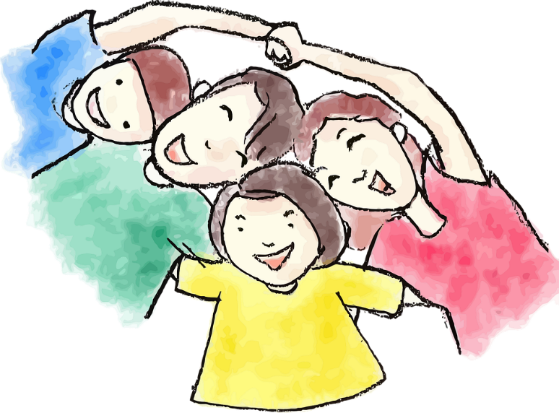
4. Reminder
BE KIND TO YOUR FAMILY
Keep connected with your family back home — kakao, skype
Keep them informed about what you are doing there

Slide 25
5. Culture Shock
CULTURE SHOCK
Refers to the anxiety and feelings (of surprise, disorientation, uncertainty, confusion, etc.) felt when people have to operate within a different and unknown cultural or social environment after leaving everything familiar behind and they have to find their way in a new culture that has a different way of life and a different mindset such as in a foreign country (cited from Wikipedia)
A term used to describe the emotional instability people feel when they are in a completely different cultural or social environment. It can be difficult to accept new cultures. It becomes difficult to know what is right and what is not. There is also a strong dislike for any aspect of new or different cultures.(First introduced in 1954 by anthropologist Kalervo Oberg)
문화 충격은 사람들이 완전히 다른 문화 환경이나 사회 환경에 있을 때 느끼는 감정의 불안을 서술하기 위해 쓰이는 용어이다. 새로운 문화를 소화하는 데 어려움을 겪을 수 있다. 다시 말해, 무엇이 올바르고 무엇이 올바르지 않는지를 알기가 어려워진다. 새롭거나 다른 문화의 어떠한 양상에 대해 강력한 혐오(도덕 또는 미학)를 느끼기도 한다. (1954년에 인류학자 칼레르보 오베르그(Kalervo Oberg)가 처음 소개)

Slide 26
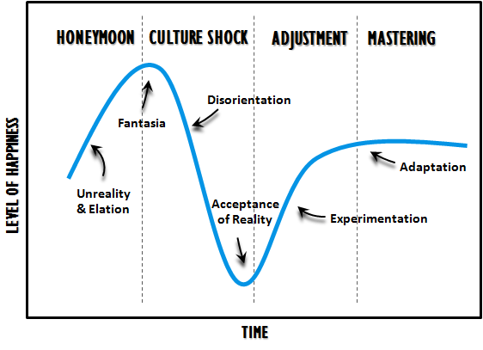
5. Culture Shock
CULTURE SHOCK

Slide 27
5. Culture Shock
SYMPTONS OF CULTURE SHOCK
Excessive concern over cleanliness and health (건강이나 청결에 대한 지난친 관심)
But, recognize your body might not be used to the cleanliness level of your
host country. Be flexible, but also be true to yourself.
Feelings of helplessness and withdrawal (포기하고 싶은 감정)
Irritability (짜증)
Desire for home and old friends, homesickness (향수)
State of frustration (좌절감)
Anxiety (불안)
Stereotyping host nationals (호스트 국가 사람들에 대한 고정관념)
Hostility towards host nationals (호스트 국가에 대한 적대감)

Slide 28
5. Culture Shock
Culture shock
Mental instability condition becomes severe due to culture shock, inform friends and coordinator from host university. It can easily get over by receiving a proper consultation, the care of his/her surroundings, rest, understanding of the other culture (문화충격으로 인해 정신적 불안정 상태 등이 심해질 경우 반드시 주변 친구, 상대교 coordinator에게 솔직히 알리고 적절하게 조치를 취할 것! 간단한 상담이나, 주변의 돌봄, 휴식, 상대 문화에 대한 설명을 통한 이해 등으로 쉽게 조치하고 넘어갈 수 있음)
Recently, there are cases of bipolar disorder and depression among students in Korea or foreign countries. When they face a new culture, symptoms may worsen, so it is desirable to check the information about common symptoms and measures in case of culture shock ( 최근에는 국내 학생 혹은 외국인 학생들 중에 조울증, 우울증등이 있는 경우가 있으며, 새로운 문화를 접할 때 증세가 악화될 수 있는 경우가 있으니, 문화충격에 대비하여 일반적인 증상 등, 조치방법등에 대해 미리 정보를 확인해 두는 것이 바람직!)

Slide 29
5. Culture Shock
CULTURE SHOCK: Accept rather than Reject
"The new comer purposefully pushes ahead and bends all efforts to understand the other system.“ "The new ways will become familiar and even comfortable only by coming back to them again and again, seeking understanding without applying the values of one's own culture" (Conrad Arensberg and Arthur H. Niehoff)

Slide 30
6. Global Etiquette
Try hard to make local friends (현지인 친구 만들기)
Good conversation topics (좋은 대화주제 선정)
  - Ask about history and local customs (역사 및 현지 문화)
  “What are your favorite places?” (좋아하는 장소는?)
    Restaurants and Parks
    Cafes
    Museums
    Cultural sites
  - Learning about university’s educational style (파견교 교육 방식 배우기)
  - Getting to know each other (서로에 대해 알아가기)
Dos

Slide 31
6. Global Etiquette
Don’ts
Smoking: check local laws to avoid penalties and shame
(흡연 관련 법규 주의!)
Pushing: try to avoid; can be dangerous (밀치지 말 것)
Garbage: follow local rules (쓰레기처리는 현지 방식대로)

Slide 32
6. Global Etiquette
Don’ts
Conversation topics to avoid (피해야 할 대화주제)
  - Don’t ask about age (나이 관련 질문)
  - Avoid discussions about blood types or purity of blood (혈액형 관련)
  - Politics (정치관련 주제)
    Avoid discussions about Dokdo, Japan, or Trump (독도, 일본, 트럼프 등)
    In general, politics are best discussed only with close friends
    (정치관련 이슈는 아주 가까운 친구들과!)
  Don’t comment on personal appearance: attractiveness, weight, skin color
  (외모, 몸무게, 피부톤 관련 언급)

Slide 33
6. Global Etiquette
Conversation topics to avoid (피해야 할 대화주제)
  For women: don’t discuss period pain as an excuse for missing class.
  (생리통을 핑계로 수업에 빠지지 말 것)
  Sexual topics are usually rude to discuss (성적인 질문은 무례함)
  - “Do you like drinking?” (술 마시는거 좋아하니?)
  - Religion (종교관련)
  - Gossip (뒷담화)
Don’ts

Slide 34
7. Conclusion
Conclusion
International Exchange should be one of the best of experiences of your life (파견프로그램은 인생의 가장 소중한 경험이 될 수 있음)
Be friendly and open new people and ways of doing things
(새로운 사람들에게 오픈 마인드로 친절하게 대할 것)
Different, not weird (이상한 것이 아닌 다른 것)
Be safe, be respectful, and enjoy every moment
(안전하고 예의바르게 행동하고, 모든 순간을 즐길 것)

Slide 35
Reference
Basic Concepts of Intercultural Communication
www.isep.org
Intercultural Communication Training: An Introduction
글로벌 시티즌을 위한 에티켓 (원융희) Etiquette for Global Citizen

Slide 36
THANK YOU
Notes:
Module 0. Introduction
Memo

