Slide 1



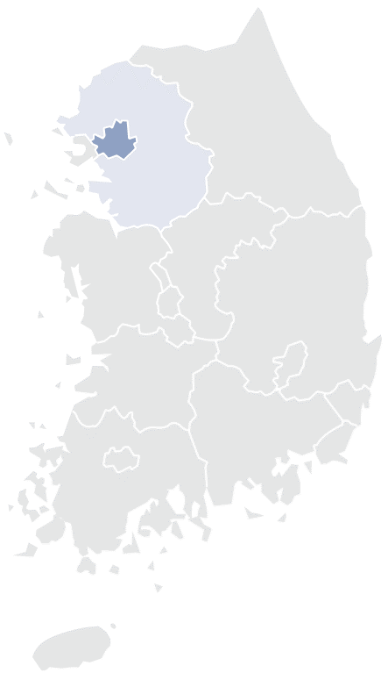
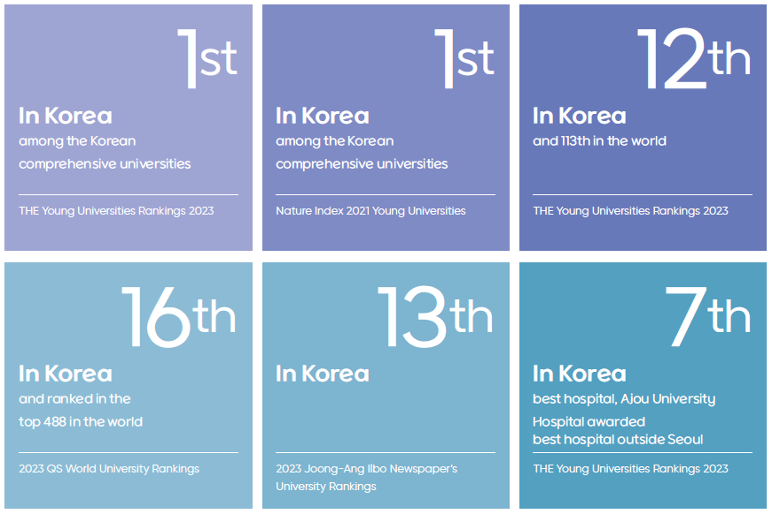




Combined
Bachelor’s Master’s
Degree Program
CBMD Program
This program is structured to spend 6 semesters at Ajou University and an additional 4 semesters at the partner university. Upon successful completion of the 4th year, students will be conferred with a Bachelor's degree from Ajou University. And Upon completion of the 4th and 5th year, the Master’s degree from the Partner institution will be conferred.
This program is meticulously structured to offer students a unique educational pathway, enabling them to acquire both a Bachelor's and a Master's degree from world top-ranked university, thereby enriching their academic journey and expanding their global perspectives.
About Ajou Univ.
Ajou University is a leading research university in South Korea established in 1973, located in the greater SeouI area. We have 13,700 domestic students and 1,400 international students from 67 countries. The university consists of 12 colleges with leading programs in fields such as artificial intelligence, future automobiles, molecular science and technology, energy systems, a medical center, and a law school.
1
2
3
4
Bachelor’s degree
for Ajou university
Master’s
degree
Overview of the Program
 | 1st~3rd year | 4th year | 5th Year Graduate
Location | Ajou University | Partner University | Partner University
Classes | Undergraduate Course at Ajou Univ. | Course at Partner Univ. | Master’s Program at Partner Univ.
Credit | Ajou University | Transfer to Ajou Univ. | Partner University
Degree |  | Bachelor's degree for Ajou Univ. | Master's degree for Partner Univ.

Slide 2
University of Illinois Chicago
Public Administration
-Civic Analytics
-Public Administration
Statistics (STEM)
-Mathematics
-IT & Software
-Big Data
Electrical Engineering (STEM)
-Computer Science Engineering
-AI
자세한 모집 요강 및 일정은 추후 공지 예정

